Slide 1
Predicting Consumer Tastes with Big Data at Gap
By Abhishek Baskar, Aryan Saxena and Shubham Gaddi

Slide 2
Product 3.0 - What, Why & How
Core Ideologies
Creative Heads shoulder too much responsibility
Time taken from Design to Distribution is too high
Success depends on Large Scale Collaboration
Key Changes
Position of Creative Directors was Eliminated Completely
Big Data Driven Processes were introduced
Operations & Supply Chain was optimised

Slide 3
Product 3.0 - Defining Success
Reduce time between Design & Distribution
Capture Fast Fashion Trends
Explore ecommerce Options
Boost Company Sales, Revenue, Profits & Gain Market Share

Slide 4
Product 3.0 - Pitfalls & Limitations
Loss in Brand Identity
One Size Fits All Approach
Capitalized on Fast Fashion but Missed out on a Long Term Strategy
Completely Eliminated Human Creative Touch

Slide 5
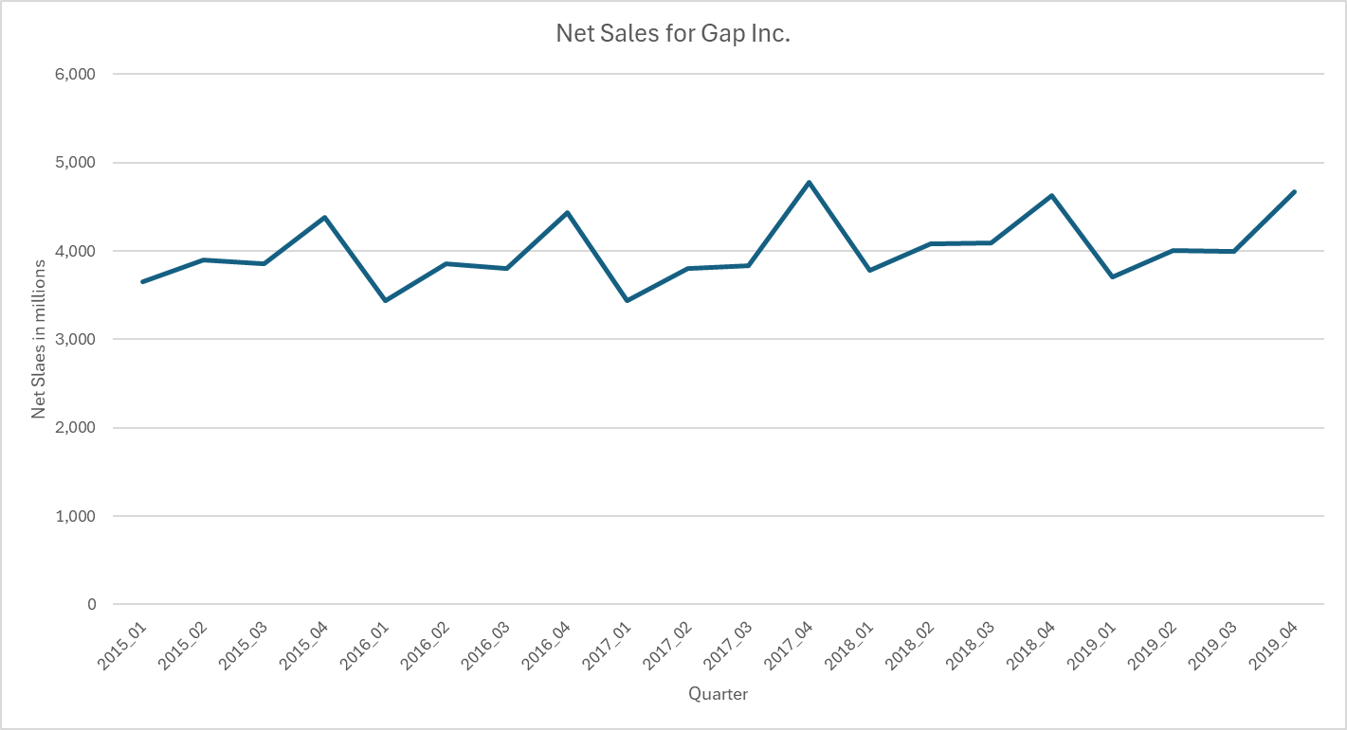
Financial Analysis - Net Sales
Net sales was more or less stagnant between 2015-19, with a ~2% drop in average sales from 2015 to 2016, a ~2% and 4.6% increase from 2016 to 2017 and 2017 and 2018 respectively, and a 1.2% drop from 2018 to 2019

Slide 6
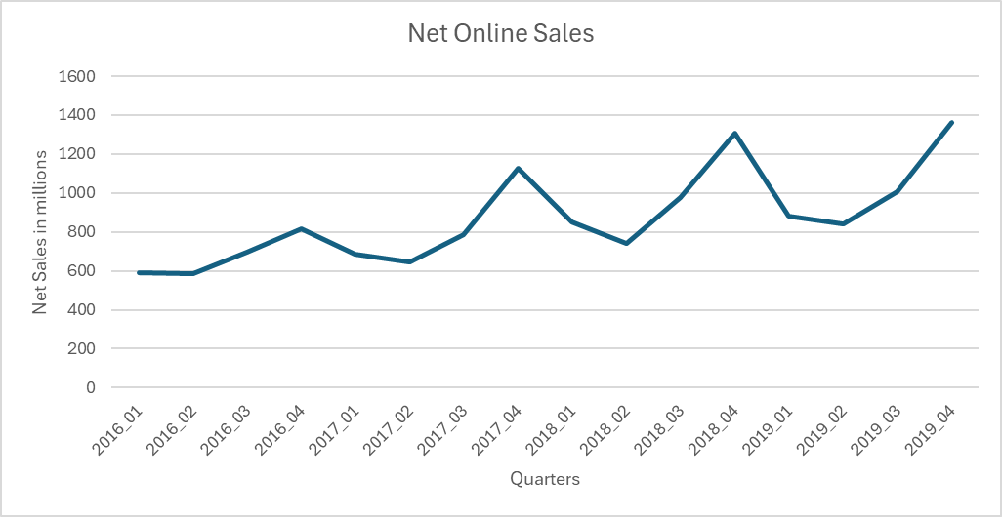
Financial Analysis - Online v/s Offline
Online sales saw a steady increase from 17% in Q1 2016 to 24% and 28% in Q3 2019 and Q4 2019, highlighting the positive impact of Peck’s focus on improving the consumer experience for online users using big data

Slide 7
Product 3.0 - Success or Failure
01
Improve Sales, Revenue and Profits
Optimize Operations
Enable Data Driven Decisions
Capture Fast Fashion Trends
Gap’s Definition of Success
02
Gain Market Share
Improve Sales, Revenue and Profits
Establishing Brand Identities
Our Definition of Success
03
Succeeded in Capturing Fast Fashion
Market Share didn’t change
Failed at boosting Sales, Revenue & Profits
Failed at establishing Brand Identities
Overall Verdict

Slide 8
Product 3.0 - Old Navy v/s Gap v/s Banana Republic
Old Navy
Gap Inc.
Banana Republic
Benefitted from Fast Fashion due to its Mass Appealing Brand Image
Saw a moderate improvement in performance
Best performing out of the 3 brands
Could not leverage Fast Fashion as well as Old Navy
Saw no improvement in performance and performance declined after 2019
Best performing out of the 3 brands
Remained rather flat in performance throughout 2015-19
Lost unique brand identity by following a data driven approach
Unable to gain a presence in the market

Slide 9
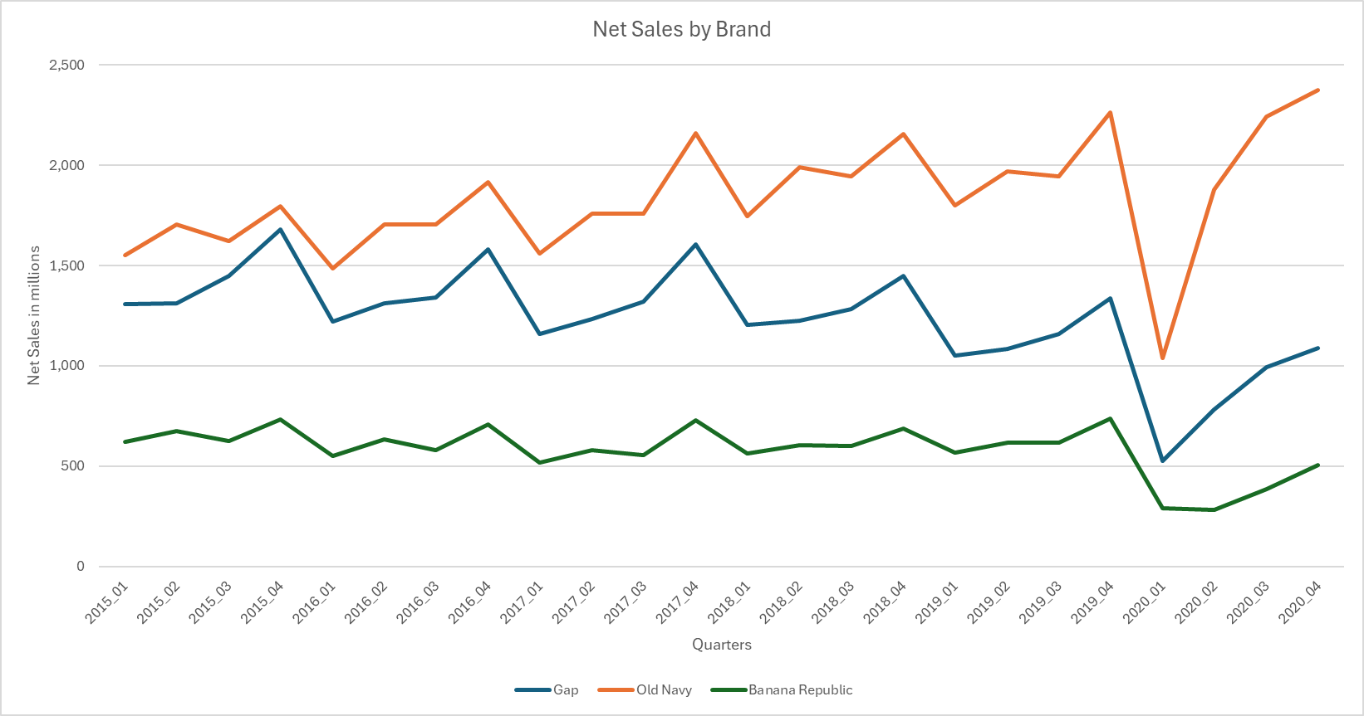
Product 3.0 - Old Navy v/s Gap v/s Banana Republic
Old Navy was best served by Product 3.0, seeing a 6% and 8% increase in average sales in 2017 and 2018 respectively. Gap had a poor performance, degrowing by 5% and 10% in 2016 and 2019 respectively. Banana Republic sales remained flat

Slide 10
Data from the Web - Customer Reviews
Data Collection:
Collected 100-200 reviews from Amazon and Gap websites
Sentiment Analysis:
Used Azure AI to analyze review sentiments and word clouds
Insights:
Varied sentiments observed; social media may skew towards negativity

Slide 11
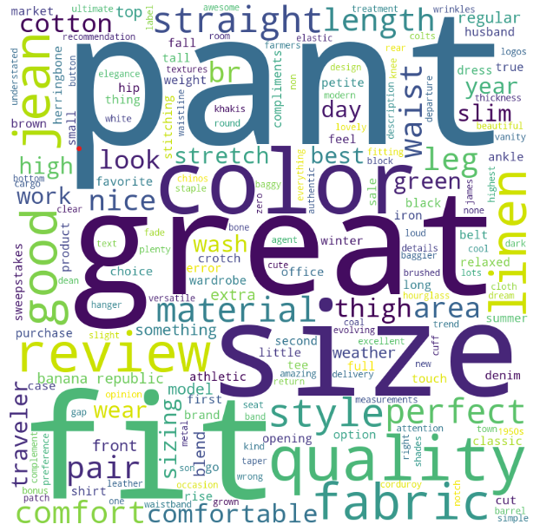
Understanding Customer Reviews
Scalability:
Extendable to other platforms based on region and popularity
Limitations:
Results may be platform-influenced, impacting sentiment accuracy
Word Cloud from Banana Republic Reviews Data

Slide 12
Data from the Web - Trends & Endorsements
Experiment with potential Limited Edition Product Lines and Ad Campaigns to maintain Relevance in the Market
3
Create Strategic Partnerships with Relevant Trending Figures to boost Reach & Social Media Presence
2
Identify Trending Public Figures - Artists & Actors
(Billboards for Regional Artists & IMDB for Regional Actors)
1

Slide 13
Competitor Pricing Analysis
Men’s Cotton T-Shirts from Gap
Make an inference about the difference in average price of a category in Gap and Macy’s
Men’s Cotton T-Shirts from Macy’s
Sample of 100 products
T-Test to understand difference in sample means
Sample of 100 products
Null Hypothesis: Price for Men’s Cotton T shirts from Gap is less than or equal to that of Macy’s
Alternate Hypothesis: Price for Men’s Cotton T shirts from Gap is greater than that of Macy’s
Result: p=97% for the test with alpha=5%, we fail to reject the null hypothesis

Slide 14
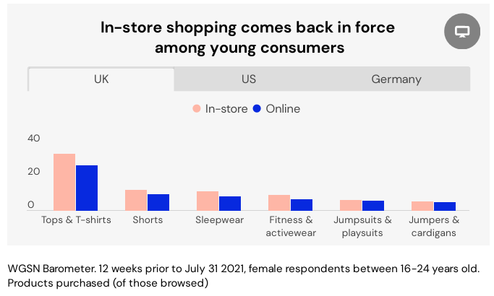
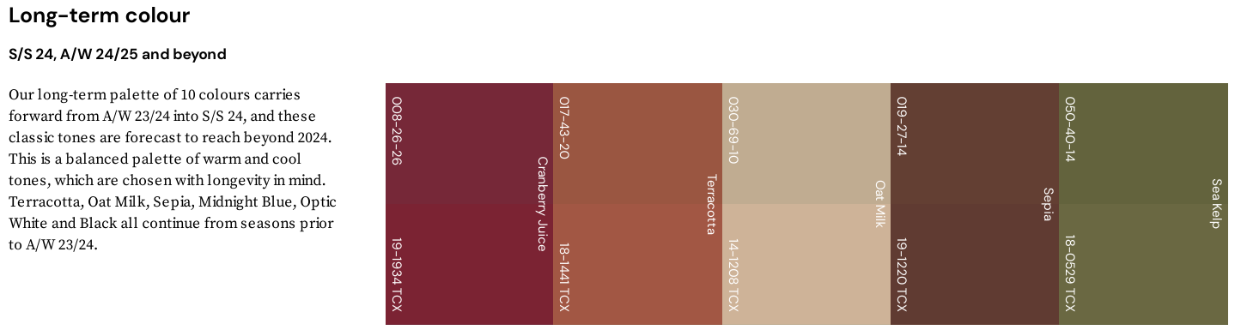
Data from the Web - 3rd Party Tools - Trend Forecasting
Fashion trend forecasting tools like WGSN, Fashion Snoops, Peclers, etc. can help in many ways:
Gap can calibrate its own forecasts using the results of a third party, catching trends their forecasts might have missed
Provide designers with inspiration for colours and silhouettes for new product lines

Slide 15
Limitations to Current Methodology
Sample Size: The size of the samples for the price analysis and the customer review sentiment analysis are not very large (~100 prices and ~110 reviews) and they may not be representative of the population
Bias in the Samples: The source of the reviews (Amazon.com and the Old Navy and Banana Republic websites) could cause some bias in the sample. Hence we run the risk of small samples that are biased
Assumptions in Calculations: In the calculation of online and offline sales, we had to approximate the net sales per franchise store as that information was not present in the 10-K or 10-Q reports

Slide 16
Biggest Problem - Lack of a Brand Image
The problem with Product 3.0 was that it tried to replace human intuition entirely with data, instead of having both of them complement each other
The latter incorporates a human touch to help in creating a brand image that is uniform in form and content for all three brands but also with enough differentiation as they cater to different segments
Data is most useful in optimizing operations and supply chain, improving customer experience in store and online, and in providing inspiration for colours and silhouettes for new product lines

Slide 17
Strategic Suggestions
Leverage Internal Pricing Data
Balance Science and Art
04
01
03
Leverage Web data and 3rd Party Tools
Focus on Strategic Partnerships
02

Slide 18
Big Data & Analytics in Marketing & Advertising
01
Web Experiments
Web Experiments to make Website Improvements and Gauge Early Market Response to New Products
02
Using Ad Campaigns on Trending Websites and Platforms to Maximize Reach
Ad Campaigns
03
Use Data Mining Techniques to provide personalised suggestions, offers and prices to customers
Website Personalisation
04
Use Purchase Patterns and Big Data to Retain Customers and Minimize Churn
Customer Retention Programs

Slide 19
Not Art v/s Science - Art + Science
Art
Creative vision shaping brand identity and unique collections.
Crucial for curated product offerings.
Science
Data-driven strategy using trends, analytics, and consumer behavior.
Best for optimizing fast-fashion brands.

Slide 20
APPENDIX

Slide 21
Market Share and Success Definition
https://chatgpt.com/share/66fb2d43-672c-8012-b798-55e5be7d846a (Table came from GPT itself but since the conversation has an Image, it cannot be shared or exported )
Gap Inc. Leadership Team Details Product and Customer Experience Strategies to Build for the Future | Business Wire
Gap Inc. Reports Second Quarter Results | Business Wire
GAP Inc. Q1, 2017 Financial Analysis - Denimandjeans | Global Trends, News and Reports | Worldwide (denimsandjeans.com)
Gap Inc. - Gap Inc. Reports Fourth Quarter And Fiscal Year 2016 Results

Slide 22
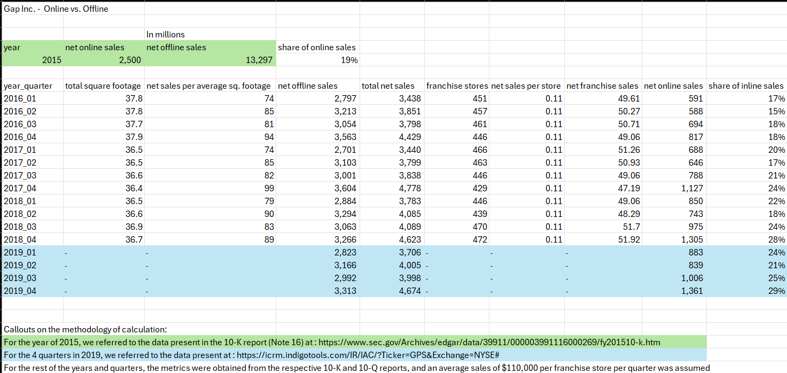
Online and Offline Sales Data

Slide 23
Callouts for the Calculation of Online Sales
For the year of 2015, we referred to the data present in the 10-K report (Note 16) at : https://www.sec.gov/Archives/edgar/data/39911/000003991116000269/fy201510-k.htm
For the 4 quarters in 2019, we referred to the data present at : https://icrm.indigotools.com/IR/IAC/?Ticker=GPS&Exchange=NYSE#
For the rest of the years and quarters, the metrics were obtained from the respective 10-K and 10-Q reports, and an average sales of $110,000 per franchise store per quarter was assumed

Slide 24
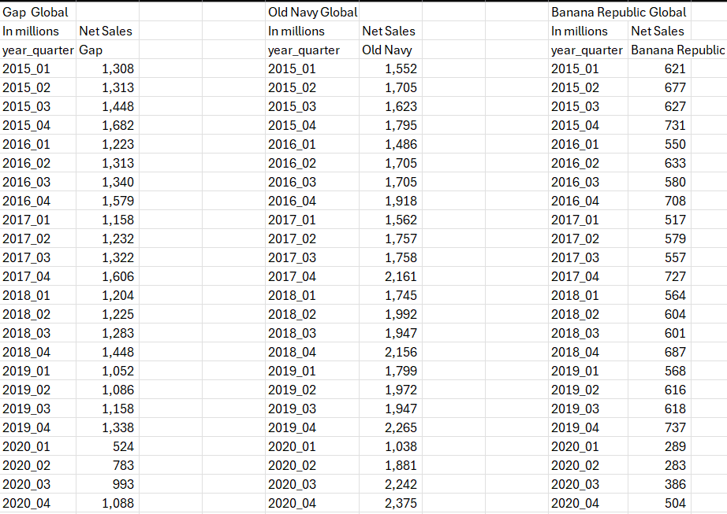
Brandwise Breakdown of Sales

Slide 25
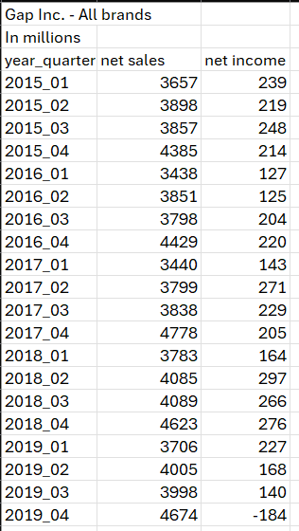
Sales for Gap Inc.

